Slide 1

Consistent Hashing Ring and OpenStack Swift Ring

Slide 2

What is Hashing?
Hashing is the process of mapping one piece of data — typically an arbitrary size object to another piece of data of fixed size, typically an integer, known as hash code or simply hash. A function is usually used for mapping objects to hash code known as a hash function.
For example, a hash function can be used to map random size strings to some fixed number between 0 … N. Given any string it will always try to map it to any integer between 0 to N.
Suppose N is 100. Then for example, for any string hash function will always return a value between 0 to 100.
Notes:
For instance, some hash function designed to hash strings, with an output range of 0 .. 100, may map the string Hello to, say, the number 57, Hasta la vista, baby to the number 33, and any other possible string to some number within that range. Since there are way more possible inputs than outputs, any given number will have many different strings mapped to it, a phenomenon known as collision. Good hash functions should somehow “chop and mix” (hence the term) the input data in such a way that the outputs for different input values are spread as evenly as possible over the output range.

Slide 3
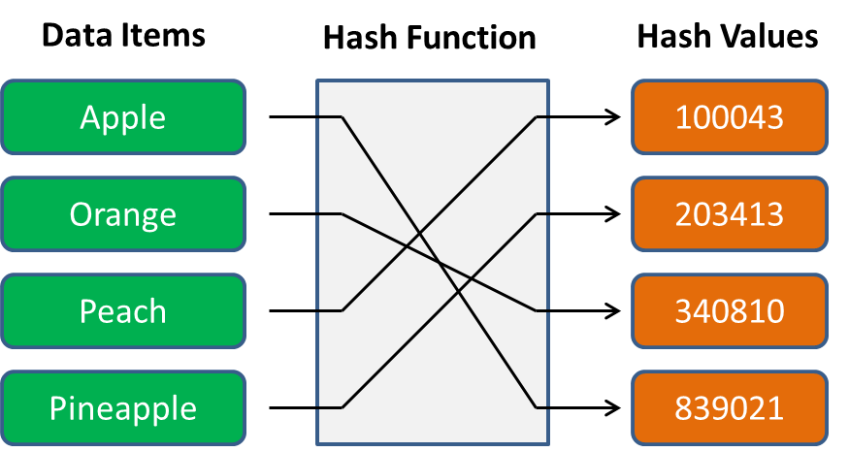
Hashing: Why?

Slide 4
Hashing is the process of applying an algorithm to convert a data item to a value. The data item can be as simple as an integer, a string, or as complex as an object with multiple properties.
The algorithm is termed the hash function or hasher. The converted value is termed the hash value, hash code, or simply hash
The above diagram shows you a simplified example of a hashing process. Essentially, we start with four kinds of fruit (i.e., data items) on the left side.
Notes:
The algorithm (i.e., hash function) can convert these four names as input to four integers (i.e., hash values) as output on the right side, which look like random numbers with no obvious connection with their original inputs

Slide 5
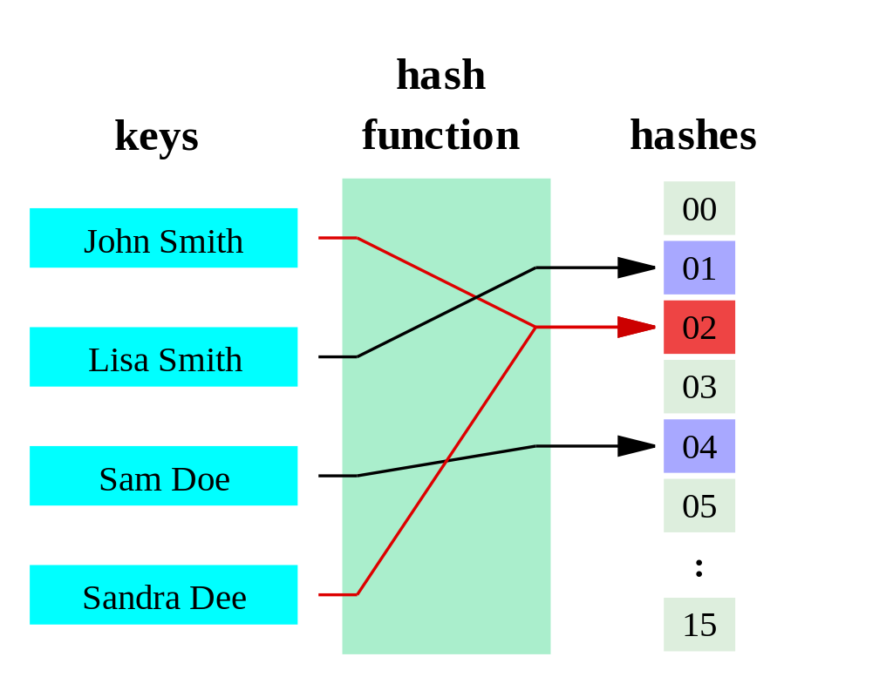
Hash Function
A hash function is any function that can be used to map data of arbitrary size to fixed-size values. The values returned by a hash function are called hash values, hash codes, digests, or simply hashes. The values are used to index a fixed-size table called a hash table.
Notes:
A hash function is a function that maps one piece of data—typically describing some kind of object, often of arbitrary size—to another piece of data, typically an integer, known as hash code, or simply hash

Slide 6
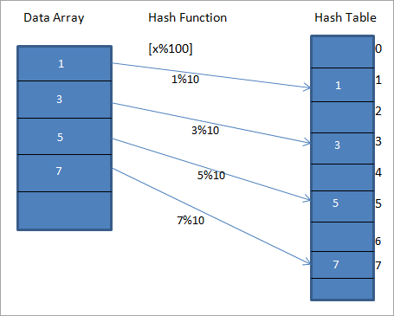
Hash function and Array
Hash function can be used to hash object key (which is email) to an integer number of fixed size. We can then use array to store the employee details in such a way that, index i has employee details whose key hash value is i. But ideally the output range of hash functions are very large, and it will be impractical and waste of memory to store objects in array
Notes:
A hash function is any function that can be used to map data of arbitrary size to fixed-size values. The values returned by a hash function are called hash values, hash codes, digests, or simply hashes

Slide 7
Distributed Hashing (Hash Table)
A distributed hash table (DHT) is a distributed system that provides a lookup service like a hash table: key-value pairs are stored in a DHT, and any participating node can efficiently retrieve the value associated with a given key. The main advantage of a DHT is that nodes can be added or removed with minimum work around re-distributing keys. Keys are unique identifiers which map to values, which in turn can be anything from addresses, to documents, to arbitrary data.[ Responsibility for maintaining the mapping from keys to values is distributed among the nodes, in such a way that a change in the set of participants causes a minimal amount of disruption. This allows a DHT to scale to extremely large numbers of nodes and to handle continual node arrivals, departures, and failures.
Notes:
Hash functions are used in conjunction with Hash table to store and retrieve data items or data records. The hash function translates the key associated with each datum or record into a hash code which is used to index the hash table. When an item is to be added to the table, the hash code may index an empty slot (also called a bucket), in which case the item is added to the table there. If the hash code indexes a full slot, some kind of collision resolution is required: the new item may be omitted (not added to the table), or replace the old item, or it can be added to the table in some other location by a specified procedure. That procedure depends on the structure of the hash table: In chained hashing, each slot is the head of a linked list or chain, and items that collide at the slot are added to the chain

Slide 8
Distributed Hash Table Properties
Autonomy and decentralization: the nodes collectively form the system without any central coordination.
Fault tolerance: the system should be reliable (in some sense) even with nodes continuously joining, leaving, and failing.
Scalability: the system should function efficiently even with thousands or millions of nodes.
A key technique used to achieve these goals is that any one node needs to coordinate with only a few other nodes in the system – most commonly, O(log n) of the n participants – so that only a limited amount of work needs to be done for each change in membership.
DHTs must deal with more traditional distributed systems issues such as load balancing, data integrity, and performance
Notes:
Hash function can be used to hash object key (which is email) to an integer number of fixed size. We can then use array to store the employee details in such a way that, index i has employee details whose key hash value is i. But ideally the output range of hash functions are very large and it will be impractical and waste of memory to store objects in array.

Slide 9
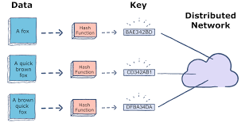
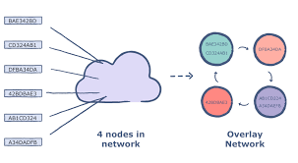
Distributed Hash Table: Structure
The structure of a DHT can be decomposed into several main components. The foundation is an abstract key space, such as the set of 160-bit strings. A key space partitioning scheme splits ownership of this key space among the participating nodes. An overlay network then connects the nodes, allowing them to find the owner of any given key in the key space.

Slide 10
Once these components are in place, a typical use of the DHT for storage and retrieval might proceed as follows. Suppose the key space is the set of 160-bit strings. To index a file with given filename and data in the DHT, the SHA-1 hash of filename is generated, producing a 160-bit key k, and a message put(k, data) is sent to any node participating in the DHT. The message is forwarded from node to node through the overlay network until it reaches the single node responsible for key k as specified by the key space partitioning. That node then stores the key and the data. Any other client can then retrieve the contents of the file by again hashing filename to produce k and asking any DHT node to find the data associated with k with a message get(k). The message will again be routed through the overlay to the node responsible for k, which will reply with the stored data.
The key space partitioning and overlay network components are described below with the goal of capturing the principal ideas common to most DHTs; many designs differ in the details.

Slide 11
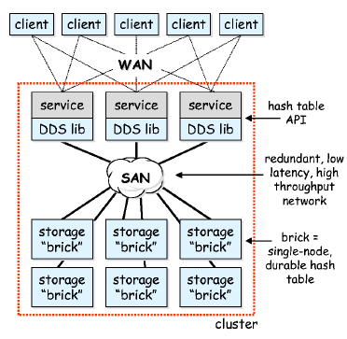
Distributed Hash Table: Architecture and Implementation
Client: a client consists of service-specific software running on a client machine that communicates across the wide area with one of many service instances running in the cluster. The mechanism by which the client selects a service instance is beyond the scope of this work, but it typically involves DNS round robin, a service-specific protocol, or level 4 or level 7 load-balancing switches on the edge of the cluster. An example of a client is a web browser, in which case the service would be a web server. Note that clients are completely unaware of DDS's: no part of the DDS system runs on a client.

Slide 12
Distributed Hash Table: Architecture and Implementation
Service: a service is a set of cooperating software processes, each of which we call a service instance. Service instances communicate with wide-area clients and perform some application-level function. Services may have soft state (state which may be lost and recomputed if necessary), but they rely on the hash table to manage all persistent state.
Hash table API: the hash table API is the boundary between a service instance and its ``DDS library''. The API provides services with put(), get(), remove(), create(), and destroy() operations on hash tables. Each operation is atomic, and all services see the same coherent image of all existing hash tables through this API. Hash table names are strings, hash table keys are 64-bit integers, and hash table values are opaque byte arrays; operations affect hash table values in their entirety.

Slide 13
Distributed Hash Table: Architecture and Implementation
DDS library: the DDS library is a Java class library that presents the hash table API to services. The library accepts hash table operations and cooperates with the ``bricks'' to realize those operations. The library contains only soft state, including metadata about the cluster's current configuration and the partitioning of data in the distributed hash tables across the ``bricks''. The DDS library acts as the two-phase commit coordinator for state-changing operations on the distributed hash tables.
Brick: bricks are the only system components that manage durable data. Each brick manages a set of network-accessible single node hash tables. A brick consists of a buffer cache, a lock manager, a persistent chained hash table implementation, and network stubs and skeletons for remote communication. Typically, we run one brick per CPU in the cluster, and thus a 4-way SMP will house 4 bricks. Bricks may run on dedicated nodes, or they may share nodes with other components.

Slide 14
Partitioning, Replication, and Replica Consistency
A distributed hash table provides incremental scalability of throughput and data capacity as more nodes are added to the cluster. To achieve this, we horizontally partition tables to spread operations and data across bricks. Each brick thus stores some number of partitions of each table in the system, and when new nodes are added to the cluster, this partitioning is altered so that data is spread onto the new node. Because of our workload assumptions, this horizontal partitioning evenly spreads both load and data across the cluster.
Each partition in the hash table is replicated on more than one cluster node. The set of replicas for a partition form a replica group; all replicas in the group are kept strictly coherent with each other. Any replica can be used to service a get(), but all replicas must be updated during a put() or remove(). If a node fails, the data from its partitions is available on the surviving members of the partitions' replica groups. Replica group membership is thus dynamic; when a node fails, all its replicas are removed from their replica groups. When a node joins the cluster, it may be added to the replica groups of some partitions (such as in the case of recovery, described later).

Slide 15
Partitioning, Replication, and Replica Consistency
To maintain consistency when state changing operations (put() and remove()) are issued against a partition, all replicas of that partition must be synchronously updated. We use an optimistic two-phase commit protocol to achieve consistency, with the DDS library serving as the commit coordinator and the replicas serving as the participants. If the DDS library crashes after prepare messages are sent, but before any commit messages are sent, the replicas will time out and abort the operation.
However, if the DDS library crashes after sending out any commits, then all replicas must commit. For the sake of availability, we do not rely on the DDS library to recover after a crash and issuing pending commits. Instead, replicas store short in-memory logs of recent state changing operations and their outcomes. If a replica times out while waiting for a commit, that replica communicates with all of its peers to find out if any have received a commit for that operation, and if so, the replica commits as well; if not, the replica aborts. Because all peers in the replica group that time out while waiting for a commit communicate with all other peers, if any receives a commit, then all will commit

Slide 16
Partitioning, Replication, and Replica Consistency
If a replica crashes during a two-phase commit, the DDS library simply removes it from its replica group and continues onward. Thus, all replica groups shrink over time; we rely on a recovery mechanism (described later) for crashed replicas to rejoin the replica group. We made the significant optimization that the image of each replica must only be consistent through its brick's cache, rather than having a consistent on-disk image. This allows us to have a purely conflict-driven cache eviction policy, rather than having to force cache elements out to ensure on-disk consistency. An implication of this is that if all members of a replica group crash, that partition is lost. We assume nodes are independent failure boundaries; there must be no systematic software failure across nodes, and the cluster's power supply must be uninterruptible.

Slide 17
Metadata maps
The first map is called the data partitioning (DP) map. Given a hash table key, the DP map returns the name of the key's partition. The DP map thus controls the horizontal partitioning of data across the bricks. As shown in figure, the DP map is a tire over hash table keys; to find a key's partition, key bits are used to walk down the tire, starting from the least significant key bit until a leaf node is found. As the cluster grows, the DP tire subdivides in a ``split'' operation. For example, partition 10 in the DP could split into partitions 010 and 110; when this happens, the keys in the old partition are shuffled across the two new partitions. The opposite of a split is a ``merge''; if the cluster is shrunk, two partitions with a common parent in the tire can be merged into their parent. For example, partitions 000 and 100 could be merged into a single partition 00.
The second map is called the replica group (RG) membership map. Given a partition name, the RG map returns a list of bricks that are currently serving as replicas in the partition's replica group. The RG maps are dynamic: if a brick fails, it is removed from all RG maps that contain it. A brick joins a replica group after finishing recovery. An invariant that must be preserved is that the replica group membership maps for all partitions in the hash table must have at least one member.

Slide 18
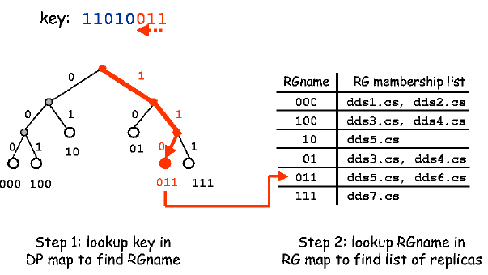
The maps are replicated on each cluster node, in both the DDS libraries and the bricks. The maps must be kept consistent, otherwise operations may be applied to the wrong bricks. Instead of enforcing consistency

Slide 19
Recovery
If a brick fails, all replicas on it become unavailable. Rather than making these partitions unavailable, we remove the failed brick from all replica groups and allow operations to continue the surviving replicas. When the failed brick recovers (or an alternative brick is selected to replace it), it must ``catch up'' to all the operations it missed. In many RDBMS's and file systems, recovery is a complex process that involves replaying logs, but in our system, we use properties of clusters and our DDS design for vast simplifications.
There is an interesting choice of the rate at which partitions are transferred over the network during recovery. If this rate is fast, then the involved bricks will suffer a loss in read throughput during the recovery. If this rate is slow, then the bricks won't lose throughput, but the partition's mean time to recovery will increase. We chose to recover as quickly as possible, since in a large cluster only a small fraction of the total throughput of the cluster will be affected by the recovery.

Slide 20
Convergence of Recovery
A challenge for fault-tolerant systems is to remain consistent in the face of repeated failures; our recovery scheme described above has this property. In steady state operation, all replicas in a group are kept perfectly consistent. During recovery, state changing operations fail (but only on the recovering partition), implying that surviving replicas remain consistent and recovering nodes have a stable image from which to recover. We also ensure that a recovering node only joins the replica group after it has successfully copied over the entire partition's data but before it release its write lease. A remaining window of vulnerability in the system is if recovery takes longer than the write lease; if this seems imminent, the recovering node could aggressively renew its write lease, but we have not currently implemented this behavior.

Slide 21
Reference:
https://medium.com/system-design-blog/consistent-hashing-b9134c8a9062
https://en.wikipedia.org/wiki/Distributed_hash_table
https://www.educative.io/edpresso/what-is-a-distributed-hash-table
https://hazelcast.com/glossary/distributed-hash-table/
https://medium.com/system-design-blog/consistent-hashing-b9134c8a9062
https://link.springer.com/referenceworkentry/10.1007%2F978-0-387-39940-9_1232
https://www.toptal.com/big-data/consistent-hashing

Slide 22

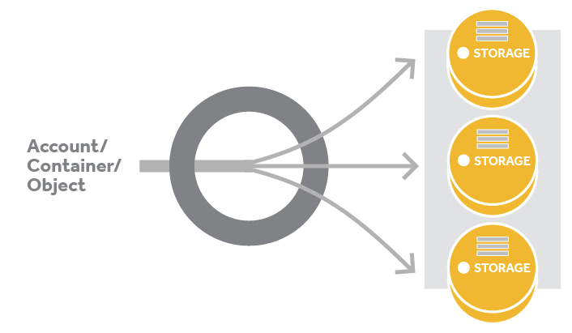



Rehashing and Rehashing Problems

Slide 23
Outline
Rehashing and Rehashing Example
How pertions are placed in swift
Active Replication of Swift
Ring Builder

Slide 24
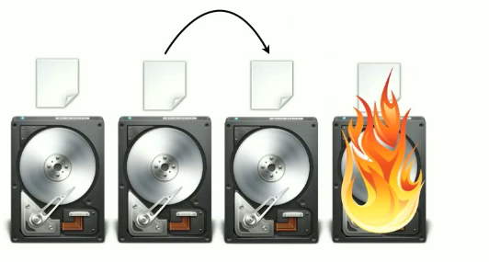
Why we need rehashing?
When one of the server crashes or becomes unavailable !
-> Keys need to be redistributed to account for the missing server.
What if one or more new servers are added to the pool
-> keys need to be redistributed to include the new servers

Slide 25
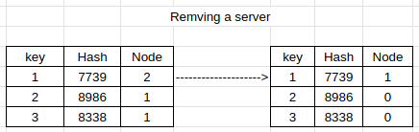
Example 1
Removing a server
For example,If we consider 3 servers. In the left side of the picture if a client wants to retrieve 1. Its hash value = 7739. It will go to Node number (7739%3). So, it will contact node 2.
If we remove server C, the allocated nodes for each key will change.
It will go to Node number (7739%2). So, it will contact node 1.

Slide 26
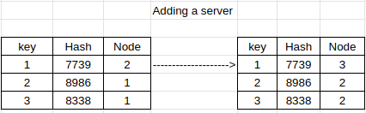
Example 2
Adding a Server
If we add server D, the allocated nodes for each key will also change.
It will go to Node number (7739%4). So, it will contact node 3.

Slide 27
PROBLEMS WITH REHASHING
The distribution changes whenever we change the number of serves.
Sometimes, the keys won’t be found because they won’t yet be present at their new location.
With the more number of redistributions, the more number of misses, the more number of memory fetches, placing an additional load on the node and thus decreasing the performance.

Slide 28
How partitions are placed in swift
If there are any unbalanced discs with uneven number of partitions in the swift. When we will run a rebalance, the swift applies a mechanism that helps to make discs with equal numbers.
Swift make sure to make data available even while moving the data
For example, While moving those partitions, if there are 3 replicas of a data. The ring builder will locks two replicas on primary nodes for a certain time, when the third one is on
the move.

Slide 29
How partitions are placed in swift(con.)
The algorithm swift uses it keeps replicas as far apart as possible. So that if any accident happen it doesn't affect the other servers
Example:
If there are 3 replicas and 3 zones. Each replica will go to a different zone.
If there are 3 replicas and 2 zones. 1 replica will go to one zone and Other two replicas will go to another zone but in different discs within the zone.

Slide 30
How partitions are placed in swift (Cont.)
Example (cont.)
If there are 3 replicas and 1 zones with 3 or more discs. Each replica will go to different discs of the same zone.
If there are 3 replicas and 1 zones with 2 discs. 1 replica will go to one disc and another 2 replica will go to the another disc. But that other discs will only keep 1 replica.
<In older version of swift it was must to have 3 separate zones for 3 replicas but with new version it is not necessary.>

Slide 31

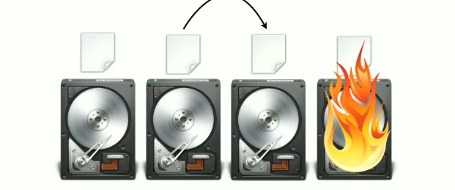
How partitions are placed in swift (Cont.)
Hand off notes
Swift supports handoff node to tackle the crisis of disc failure.
Swift use active replication means one node asks other nodes if they have a copy of the other replications within a short span of time. If It find out one disc is not working properly it makes a copy from the remaining replica and passes it to another working disc. When the fail disc again start working it passes the copy to the desired disc.

Slide 32
Active Replication
In the background swift runs an active consistency check that reads the uploaded object of a disc and makes sure their checksum matches. If swift finds any checksum of an object that doesn't match it discards the object and places it in a trash directory.
It also runs an active replication check consistently and if it finds any desired disc is missing any object , it creates a copy from the remaining replicas and places it on the desired disc.

Slide 33
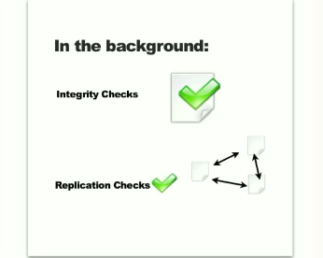
Active Replication

Slide 34
Ring Builder
Ring Builder is a configure that is run offline by system Admin. This configure file handle many operations. Such as:
Add a device
Remove a device
Rebalance

Slide 35
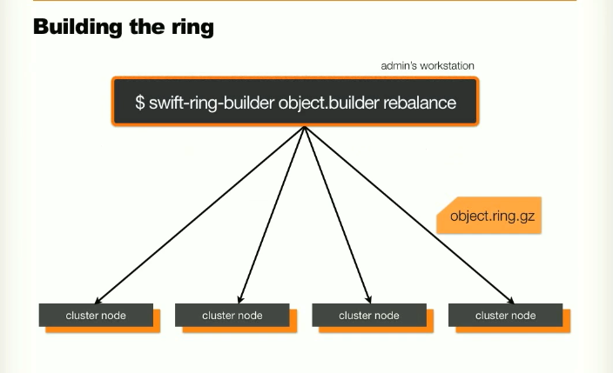
Ring Builder

Slide 36
What next?
How to solve rehashing problem
Consistent Hashing

Slide 37
References
OpenStack Swift
A Guide to Consistent Hashing
Hashing in Distributed Systems
Distributed Database Things to Know: Consistent Hashing

Slide 38
How to solve rehashing problem
In the distributed system, there are lots of data and and lots of metadata. When we do rehashing it kept alive until the servers are alive. That means, at least when a server need a maintenance break, and shouted down or rebooted, hashing will be changed and we will lost where, what will be and what’s hashing is which one. Like wisely, if needs a new server or a server crashed or got missing or a new server to add, every time there will be need of a new hashing, as most hashes modulo N will change.

Slide 39
Example of rehashing problem
Key | Hash | Hash mod 3
Shamiul | 77788899 | 0
Sakib | 55566770 | 1
Sakif | 99887700 | 2
A B C
Location Of Data
Shamiul -> A
Sakib -> B
Sakif -> C

Slide 40
Key | Hash | Hash mod 3
Shamiul | 77788899 | 0
Sakib | 55566770 | 1
Sakif | 99887700 | 0
A B
Location Of Data after losing a server
Shamiul -> A
Sakib -> B
Sakif -> A

Slide 41
Solution :
As Rehashing, directly dependent on the number of server in that system. If it is possible to remove this dependency, our problem is solved. If we able to do this, at the time of added a server or removing server, the number of keys generates will be minimized. That one such brilliant schema is called Consistent Hashing.

Slide 42
Consistent Hashing
Consistent hashing, was first come to public by Karger et al. at MIT in an academic paper from 1997(according to Wikipedia).
Consistent Hashing operates independently of the server or objects in a distributed system’ hash table by assigning a place or position on hash ring or an abstract circle, which allows servers and objects to scale any time without affecting the whole system.

Slide 43
How Consistent Hashing Work
As, we know, Consistent hashing set a position for server or object. if we mapped the hash output range in a edge of a circle, the minimum possible corresponding angle will be zero, and the possible maximum value will be in a big integer, and corresponding angle of 360 degrees, and all other values will take position in between them. For this, if we take a key and compute its hash, we can find out about it’s position on the circle’s edge.
Let’s take a value, 7 for the maximum value, see the mapping

Slide 44
How Consistent Hashing Work
Shamiul
Key | Hash | Angle
Shamiul | 889977 | 75
Sakib | 778899 | 180
Sakif | 665544 | 352
Sakib
Sakif

Slide 45
How Consistent Hashing Work
A
Shamiul
We placed the servers on the edge of the circle, by pseudo-randomly assigning them angles too. This should be done in a repeatable way . But a convenient way to do this thing is hashing the server name, or IP address, or some ID, and for any other key with the angle.
Sakib
B
Sakif
C

Slide 46
How Consistent Hashing Work
Key | Hash | Angle
Shamiul | 889977 | 75
Sakib | 778899 | 180
Sakif | 665544 | 352
A | 554890 | 95
B | 689012 | 190
C | 998812 | 285
As, we have the keys for the both objects and servers on the same circle, we can set rules to the existings, as well as for the new, likewise: set each object key to belongs in the nearest server, in a clockwise direction or in a counterclockwise.

Slide 47
How Consistent Hashing Work
A
Shamiul
Key | Hash | Angle
Shamiul | 889977 | 75
A | 554890 | 95
Sakib | 778899 | 180
B | 689012 | 190
Sakif | 665544 | 352
C | 998812 | 285
Sakib
B
Sakif
C

Slide 48
How Consistent Hashing Work
we will keep a sorted list of server values (which could be angles or numbers in any real interval), and walk this list (or use a binary search) to find the first server with a value greater than, or equal to, that of the desired key. If no such value is found, we need to wrap around, taking the first one from the list.
Key | Hash | Angle | Label | Server
Shamiul | 889977 | 75 | “A” | A
Sakib | 778899 | 180 | “B” | B
Sakif | 665544 | 352 | “C” | C

Slide 49
How Consistent Hashing Work
For making sure object keys are distributed evenly in all servers, we can use weight rules and rather then using many labels for each server, we can use scattered or distribute the servers along the circle. In example, we have servers like “A”, “B”, “C”, instead of having this labels, we can use “A0”.... “A9”, “B0”... “B9” etc. As we said using the weight rules, which will help to balance the server’s load balancing. For example if server A is twice as powerful as the others, then it can be assigned twice as many labels, and as a result, it would end up holding twice as many objects and reduce pressure from the other less powerful servers

Slide 50
How Consistent Hashing Work
A
Key | Hash | Angle
B3 | 46554 | 94
A2 | 36328 | 100
A1 | 25525 | 105
B2 | 65620 | 175
B1 | 89324 | 185
A4 | 87464 | 200
C3 | 35265 | 215
Key | Hash | Angle
B4 | 53244 | 25
C4 | 35420 | 19
A3 | 54836 | 14
C7 | 98536 | 285
C6 | 63540 | 280
B5 | 25755 | 275
A1 A2
B3
Shamiul
B4
C4
A3
B2
B1
A4
C3
Sakib
B
Sakif
C
B5 C6
C7

Slide 51
How Consistent Hashing Work
Rather than having liner schema, in circle schema we can add remove server and hash them easily. If we remove a server, we need to remove labels as well as from the circle, and this is hash the objects randomly and label, reassign them in to other servers. And these does not even affect the existing object keys, leave all other keys untouched.
Key | Hash | Angle | Label | Server
Shamiul | 889977 | 75 | “A2” | A
Sakib | 778899 | 180 | “B1” | B
Sakif | 665544 | 352 | “C7” | C

Slide 52
How Consistent Hashing Work
A
A1 A2
B3
Shamiul
Key | Hash | Angle
B3 | 46554 | 94
A2 | 36328 | 100
A1 | 25525 | 105
B2 | 65620 | 175
B1 | 89324 | 185
A4 | 87464 | 200
B4 | 53244 | 25
A3 | 54836 | 14
B5 | 25755 | 275
Key | Hash | Angle | Label | Server
Shamiul | 889977 | 75 | “A2” | A
Sakib | 778899 | 180 | “B1” | B
Sakif | 665544 | 352 | “A3” | A
B4
A3
B2
B1
A4
Sakib
B
Sakif
B5

Slide 53
How Consistent Hashing Work
A
Similar ways, If we add a server, we will label new server and distribute and one -third of the existing keys will be reassigned to new server and others will kept same.
A1 A2
B3
D3
Shamiul
D4
B4
A3
B2
B1
A4
D2
Sakib
B
Sakif
B5 D1

Slide 54
How Consistent Hashing Work
Key | Hash | Angle
B3 | 46554 | 94
A2 | 36328 | 100
A1 | 25525 | 105
B2 | 65620 | 175
B1 | 89324 | 185
A4 | 87464 | 200
B4 | 53244 | 25
A3 | 54836 | 14
B5 | 25755 | 275
Key | Hash | Angle
D1 | 56782 | 108
D2 | 79585 | 205
D3 | 89152 | 285
D4 | 78556 | 30
Key | Hash | Angle | Label | Server
Shamiul | 889977 | 75 | “A2” | A
Sakib | 778899 | 180 | “B1” | B
Sakif | 785566 | 352 | “D1” | D

Slide 55
How Consistent Hashing Work
This is how, consistent hashing works.
In simply, only k/N keys need to be remapped when k is the number of keys and N is the number of servers and more specifically, the maximum of the initial and final number of servers.

Slide 56
References
https://www.toptal.com/big-data/consistent-hashing
http://courses.cse.tamu.edu/caverlee/csce438/readings/consistent-hashing.pdf
https://www.researchgate.net/figure/Virtual-Rehashing-of-RQALSH-for-c-2_fig1_319867705
https://www.ably.io/blog/implementing-efficient-consistent-hashing

Slide 57
Acknowledge to
Md Shamiul Islam – 17301108
Md Nazmur Sakib – 17301124
Md Sadiqul Islam Sakif – 17301137

